Slide 1


CAPSTONE: GROUP 8
DOT SENTINEL AI
Agentic AI Powered CyberSecurity Dashboard
AASHINA SAXENA
22BCE10114
NANDINI SHARMA
22BCE10071
PARTHIB SARKAR
22BCE10708
PRAKHAR SHUKLA
22BCE10247
SIDDHANT JHA
22BCE10720

Slide 2


Dot Sentinel AI is an innovative cybersecurity dashboard designed to simplify the analysis of .PCAP log files using agentic AI, enabling rapid detection of network threats like malware, unauthorized access, or anomalies. It autonomously processes complex packet data, generating clear, user-friendly reports with intuitive visualizations that cater to both technical and non-technical users. The platform provides prioritized, actionable recommendations—such as blocking malicious IPs or updating protocols—to resolve identified issues efficiently. With scalable, secure processing, Packet Sentinel AI empowers organizations to strengthen their cybersecurity posture, reduce response times, and protect critical assets effectively.
WHAT IS DOT SENTINEL ?
PAGE 2

Slide 3
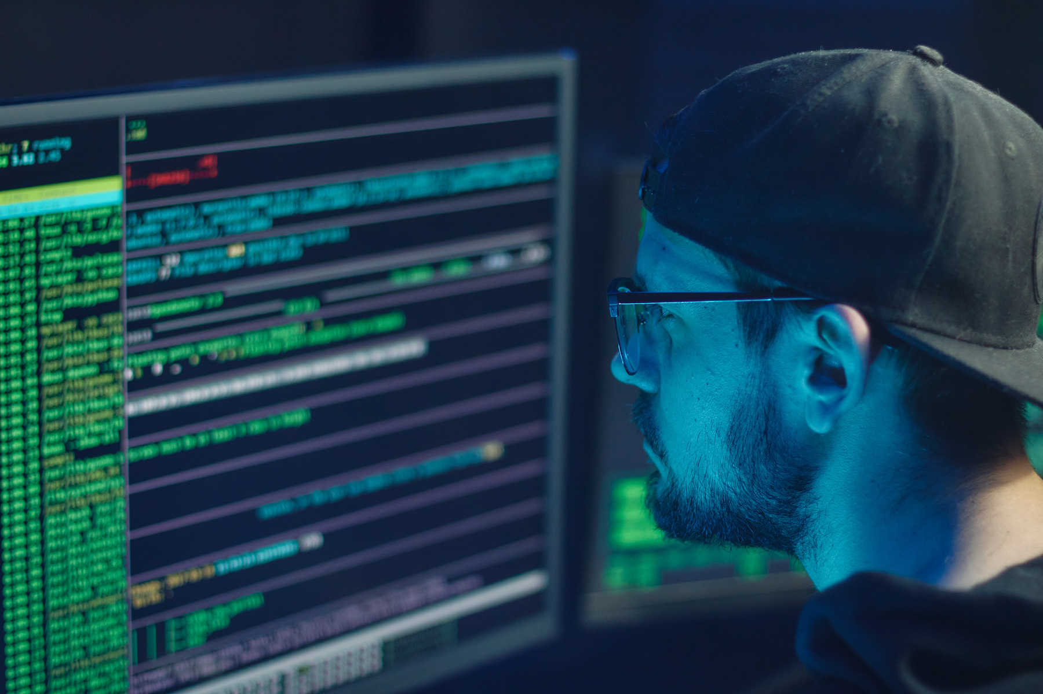



PROBLEM STATEMENT
Network security teams encounter significant obstacles when analyzing .PCAP (Packet Capture) log files to detect cybersecurity threats, such as malware, unauthorized access, or network anomalies. These files, often large and complex, demand specialized expertise and time-intensive manual analysis, which can lead to delays or errors in identifying critical issues. Current tools frequently produce technical outputs that are challenging for non-expert users to interpret, hindering effective decision-making. Moreover, many solutions fail to offer clear, prioritized recommendations for resolving detected threats, leaving organizations vulnerable to persistent risks.
DOT Sentinel AI aims to address these challenges by leveraging agentic AI to autonomously analyze .PCAP files, delivering user-friendly, jargon-free reports that highlight threats and anomalies with clear visualizations. The dashboard will provide actionable, prioritized mitigation strategies—such as updating protocols, blocking malicious IPs, or isolating compromised devices—tailored to users of varying expertise levels. By automating analysis, simplifying outputs, and ensuring scalable, secure processing,
PAGE 3

Slide 4

OBJECTIVES
Enhance Cyber Threat Detection
Develop advanced methodologies to detect and prevent cyber threats using the latest technologies and practices in modern cybersecurity.
Strengthen Network Security
Implement robust security measures to safeguard network infrastructures from unauthorized access, malware, and other vulnerabilities.
Promote Data Privacy and Integrity
Ensure that sensitive data is protected against breaches and that its integrity is maintained through encryption and secure storage practices.
Implement Risk Management Strategies
Assess and manage potential cybersecurity risks by establishing a proactive approach to identifying and mitigating vulnerabilities.
Develop Cybersecurity Awareness
Educate stakeholders and users about best practices in cybersecurity to minimize human-related security breaches and promote a culture of security-first thinking.
Leverage Advanced Technologies
Incorporate cutting-edge technologies such as AI, machine learning, and automation tools to improve threat analysis, incident response, and system resilience.
PAGE 4

Slide 5
LITERATURE REVIEW
This literature review examines the integration of AI-based anomaly detection and agentic AI in enhancing cybersecurity, focusing on real-time threat detection and autonomous anomaly management.
1. AI and Cyber-Security (Katiyar [3]):
This article discusses using machine learning models like decision trees and SVMs for threat detection and malware classification, noting their effectiveness in improving detection rates despite challenges with false positives.
2. AI-Based Anomaly Detection (Goswami [2]):
This paper focuses on using neural networks, SVMs, and clustering for real-time anomaly detection, highlighting a framework that achieves high accuracy but faces computational challenges.
3. Agentic AI for Anomaly Management (Barenji [1]):
This narrative review examines how agentic AI and large language models (LLMs) provide adaptable, autonomous anomaly detection and intervention by analyzing multiple data sources.
Conclusion :
The research by Katiyar, Goswami, and Barenji highlights how AI has advanced cybersecurity by moving from traditional anomaly detection to more autonomous and adaptive threat management with Agentic AI.
PAGE 5

Slide 6
How Our Project Differs ?
Unlike Katiyar [3] and Goswami [2], which focus on general ML for anomaly detection without specific input sources, our project uses Wireshark logs (PCAPs) parsed via Tshark for targeted network traffic analysis, avoiding ensemble/deep learning or autoencoders/clustering.
In contrast to Barenji [1], which emphasizes LLM-based agents for generic complex systems, our cybersecurity dashboard employs agentic AI (CrewAI/AutoGen) for multi-agent workflows, MITRE ATT&CK mapping, and real-time recommendations/visualizations via FastAPI/React.js/Grafana—not relying on generic telemetry or RCF.
Our approach integrates end-to-end real-time monitoring, threat interpretation, and user-friendly dashboards, differentiating it by focusing on Wireshark-specific, impossible-to-replicate techniques for practical, deployable cybersecurity.
PAGE 6

Slide 7
System Overview
THE CYBERSECURITY DASHBOARD PROJECT LEVERAGES A SIMPLIFIED TECH STACK TAILORED, FOCUSING ON REAL-TIME MONITORING AND ANOMALY DETECTION USING WIRESHARK LOGS. THE SYSTEM INTEGRATES DATA INGESTION, ANOMALY DETECTION WITH MACHINE LEARNING, AGENTIC AI FOR INTERPRETATION AND RECOMMENDATIONS, AND A REACT.JS FRONTEND WITH CHART.JS FOR VISUALIZATION, ALL RUNNING ON A SINGLE MACHINE.
COMPONENTS:
DATA INGESTION & PARSING
STORAGE
ANOMALY DETECTION
AGENTIC AI
BACKEND
FRONTEND:
DEPLOYMENT:
PAGE 7

Slide 8
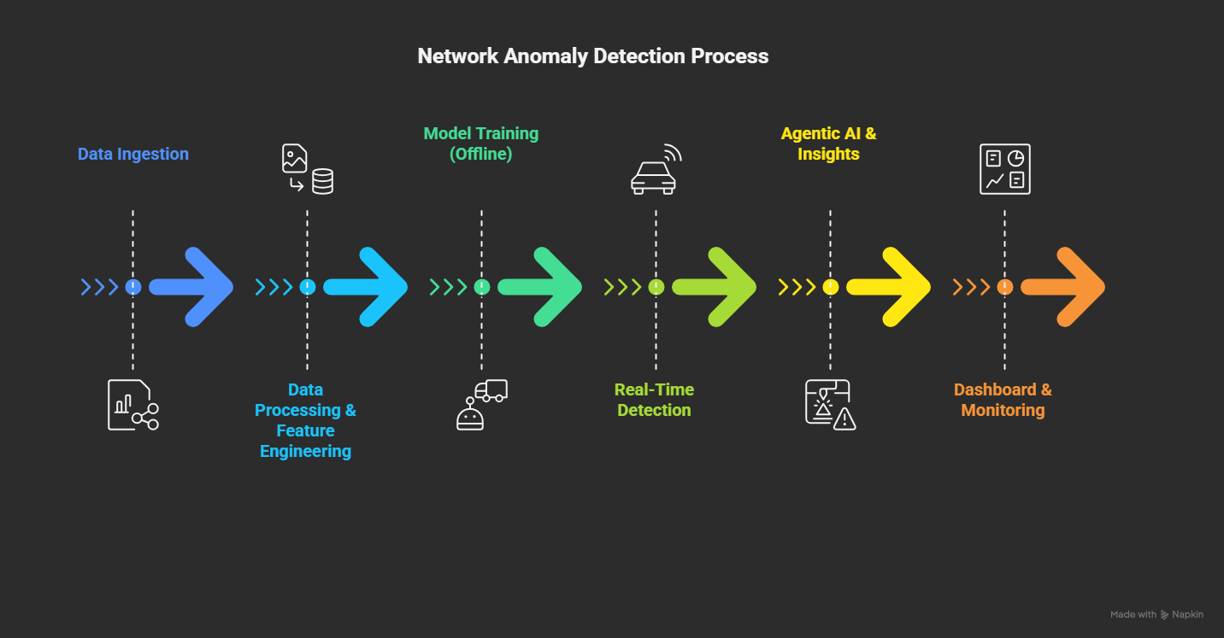
WORKFLOW:
PAGE 9

Slide 9

METHODOLOGY
PHASE-1
FOUNDATION AND TRAINING
1.1 DATA COLLECTION & INGESTION
Acquire a public, labeled network traffic dataset (e.g., CIC-IDS2017 or UNSW-NB15) in PCAP format.
Store the parsed logs and metadata in a structured format for the next steps
1.2 DATA PREPARATION
Key feature extraction like packet count, duration, bytes sent/received, protocol type, flags
Handle missing values, encode categorical variables and normalize numerical features to a consistent scale.
1.3 MODEL TRAINING
Utilize Hybrid Approach o train both signature-based and anomaly-based models to ensure a comprehensive detection capability.
The system uses ML models (like Isolation Forest) to detect unusual network behavior.
PAGE 10

Slide 10


PHASE-2
BACKEND DEVELOPMENT & AI INTEGRATION
2.1 ANOMALY DETECTION
The backend processes the traffic and feeds it to the trained model for real-time predictions.
2.2 ALERT & STORAGE:
When an anomaly is detected, the backend stores the raw alert data in a database , SQLite
2.3 AGENTIC AI & THREAT INTELLIGENCE
Integrate a lightweight LLM (e.g., Ollama or Grok API) into the backend.
The LLM's task is to interpret the alert in natural language and provide a summary of the potential threat.
The LLM is prompted to map the detected behavior to a specific tactic and technique from the MITRE ATT&CK framework.
The AI also checks the source IP against a threat intelligence feed (e.g., MISP)
PAGE 11

Slide 11

PHASE-3
FRONTEND & DASHBOARD
3.1 Dashboard Design
The frontend, built with a framework like React.js, will be designed to visualize the data.
3.2 Real-Time Visualization
The dashboard will use a library like Chart.js to display key metrics.
A stream of alerts, displaying the anomaly score, source/destination IPs, and a brief description.
3.3 Agentic AI Insights Panel
A visualization showing which tactics and techniques have been observed on the network using MITRE ATT&CK Map
A dedicated section that displays the natural-language summaries and recommendations generated by the LLM, providing instant context to the user
PAGE 12

Slide 12
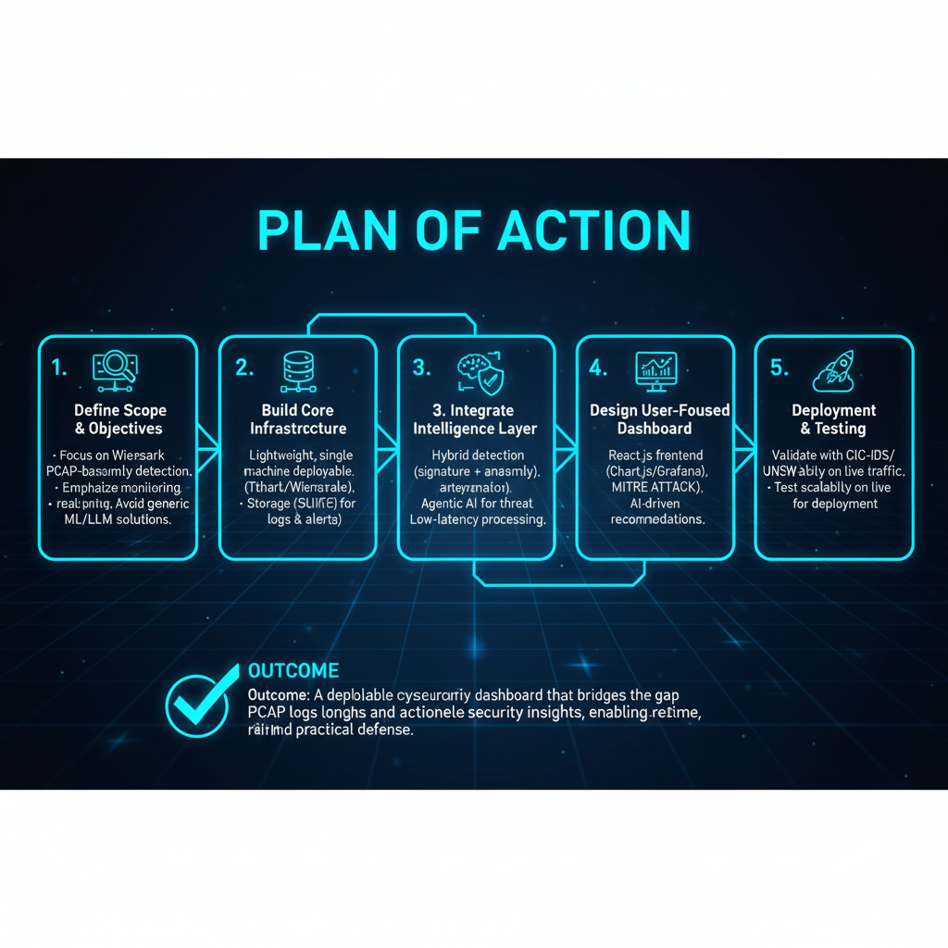
PLAN OF ACTION
PAGE 13

Slide 13


CHALLENGES AND RISK MITIGATION
1. Data Complexity
Challenge: PCAP files are large, unstructured, and resource-heavy.
Mitigation: Use Tshark-based parsing and feature extraction pipelines to streamline processing.
2. Model Accuracy
Challenge: False positives/negatives may cause alert fatigue or missed threats.
Mitigation: Apply a hybrid detection approach (signature + anomaly) and continuous retraining with updated datasets.
3. Threat Intelligence Integration
Challenge: Outdated feeds reduce detection quality.
Mitigation: Automate MISP/IP reputation feed updates with fallback checks for unknown sources.
PAGE 14

Slide 14
4. Real-Time Performance
Challenge: Achieving low latency on a single-machine deployment.
Mitigation: Optimize backend using FastAPI async processing and lightweight storage (SQLite).
5. System Security
Challenge: The dashboard itself could become a target.
Mitigation: Enforce authentication, role-based access control, and regular patching.
6. User Adoption
Challenge: Non-technical users may struggle with complex visualizations.
Mitigation: Provide intuitive dashboards with MITRE ATT&CK heatmaps, plain-language summaries, and user training.
PAGE 15

Slide 15
Future Scope
CLOUD-BASED DEPLOYMENT: EXPAND THE DASHBOARD TO SUPPORT CLOUD-NATIVE ENVIRONMENTS, ENABLING SEAMLESS MONITORING OF DISTRIBUTED SYSTEMS AND HYBRID INFRASTRUCTURES.
IOT SECURITY MONITORING: INCORPORATE FEATURES TO MONITOR AND SECURE INTERNET OF THINGS (IOT) DEVICES, ADDRESSING THE GROWING ATTACK SURFACE IN SMART ECOSYSTEMS.
AUTOMATION OF INCIDENT RESPONSE: IMPLEMENT AUTOMATED RESPONSE MECHANISMS TO MITIGATE THREATS FASTER, REDUCING MANUAL INTERVENTION AND RESPONSE TIME.
ENHANCED USER BEHAVIOR ANALYTICS: INTEGRATE ADVANCED USER BEHAVIOR ANALYTICS TO DETECT INSIDER THREATS AND ANOMALOUS ACTIVITIES WITH GREATER ACCURACY.
BLOCKCHAIN FOR SECURE DATA SHARING: UTILIZE BLOCKCHAIN TECHNOLOGY TO ENSURE TAMPER-PROOF LOGGING AND SECURE SHARING OF CYBERSECURITY DATA ACROSS ORGANIZATIONS.
PAGE 16

Slide 16
Future Scope
SCALABILITY FOR SMES: DEVELOP LIGHTWEIGHT, COST-EFFECTIVE VERSIONS OF THE DASHBOARD TAILORED FOR SMALL AND MEDIUM ENTERPRISES (SMES) TO BROADEN ACCESSIBILITY.
INTEGRATION WITH THREAT INTELLIGENCE PLATFORMS: ENABLE SEAMLESS INTEGRATION WITH GLOBAL THREAT INTELLIGENCE FEEDS TO PROVIDE UP-TO-DATE INSIGHTS ON EVOLVING CYBER THREATS.
CUSTOMIZABLE DASHBOARDS: OFFER HIGHLY CUSTOMIZABLE INTERFACES TO CATER TO SPECIFIC INDUSTRY NEEDS, SUCH AS FINANCE, HEALTHCARE, OR CRITICAL INFRASTRUCTURE.
ZERO TRUST ARCHITECTURE SUPPORT: EVOLVE THE DASHBOARD TO ALIGN WITH ZERO TRUST SECURITY MODELS, ENSURING CONTINUOUS VERIFICATION AND MONITORING OF ALL NETWORK ACTIVITIES.
PAGE 17

Slide 17
REFERENCES
Agentic AI for autonomous anomaly managmaent in complec system (https://arxiv.org/pdf/2507.15676)
AI-Based Anomaly Detection for Real-Time Cybersecurity(https://tinyurl.com/ytf6s9wj )
AI and Cyber-Security: Enhancing Threat Detection and Response with Machine Learning(https://tinyurl.com/8aryztus)
PAGE 18

